Slide 1
ECE4321 Computer Networks
Chapter 7
HDLC

Slide 2
High –level Data Link Control
Bit oriented protocol
For communication over point to point and multipoint links
WAN communication

Slide 3
HDLC Station Types
Primary station
  Controls operation of link
  Issues commands (frames)
  Maintains separate logical link to each secondary station
Secondary station
  Under control of primary station
  Issues responses (frames)
Combined station
  May issue commands and responses
  Combines the features of primary and secondary stations

Slide 4
HDLC Link Configurations
Unbalanced
  One primary and one or more secondary stations
  Supports full duplex and half duplex
Balanced
  Two combined stations ie
  Each station can function as a primary and secondary.
  Supports full duplex and half duplex

Slide 5
HDLC Transfer Modes (1)
Normal Response Mode (NRM)
  Unbalanced configuration
  Primary can only initiate transmission
  Secondary may only transmit data in response to command (poll) from primary.
  Used for both point to point and multi-point links.

Slide 6
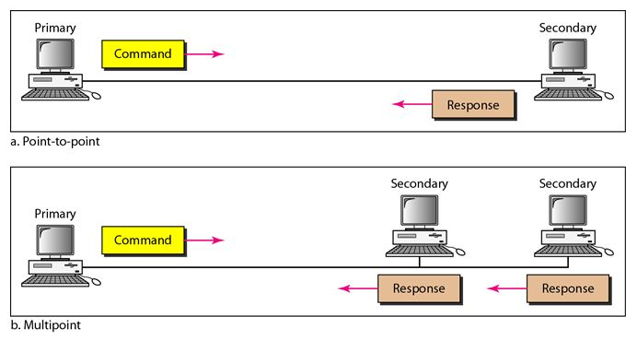

Slide 7
HDLC Transfer Modes (2)
Asynchronous Balanced Mode (ABM)
  Balanced configuration
  Link is point to point.
  Either station can function as a primary and a secondary
  Most widely used

Slide 8
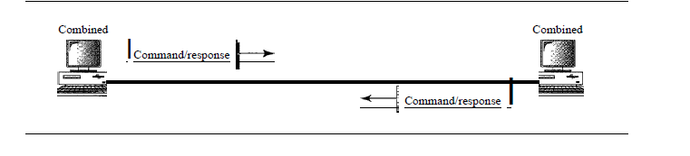

Slide 9
Frame
3 types frames
  Information frame (I frame)
  Supervisory frames(S frames)
  Unnumbered frames(u frames)

Slide 10
I-frames :Transports user data and control infromation relating to user data.
S-frame :transports control information
U-frame : reserved for system management

Slide 11
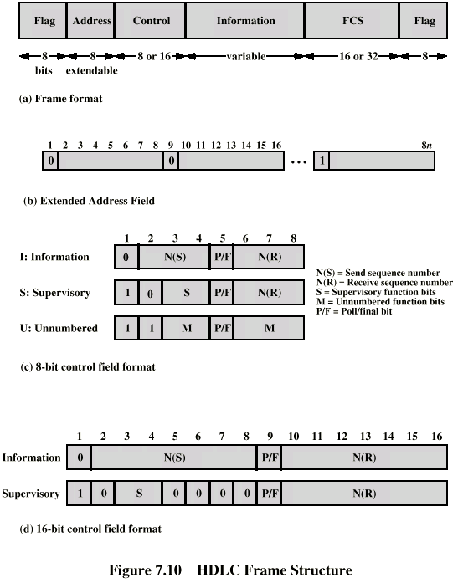
Frame Structure
Defines 3 types of frames (I,S,U frames)
01111110
01111110

Slide 12
Flag Fields
Delimit frame at both ends
01111110
Receiver hunts for flag sequence to synchronize
Bit stuffing used to avoid confusion with data containing 01111110
  The transmitter inserts 0 bit after every sequence of five 1s with the exception of flag fields
  If receiver detects five 1s it checks next bit
    If 0, it is deleted
    If 1 and seventh bit is 0 (i.e., 10), accept as flag
    If sixth and seventh bits 1 (i.e., 11), sender is indicating abort

Slide 13
Address Field
Identifies secondary station that sent or will receive frame
Usually 8 bits long
May be extended depending on the need of the network
  LSB of each octet indicates that it is the last octet (1) .
All ones (11111111) is broadcast

Slide 14
Control Field
Used for flow and error control.
Different for different frame type
  I-frame (information frame)
    data to be transmitted to user (next layer up)
    Flow and error control piggybacked on information frames
  S-frame (Supervisory frame)
    Used for flow and error control
  U-frame (Unnumbered frame)
    supplementary link control
First one or two bits of control filed identify frame type
0-I frame ,10-S frame,11-U frame
,

Slide 15
Control Field Diagram

Slide 16
Poll/Final Bit
Use depends on context
Command frame
  P bit : used for poll from primary
  1 to solicit (poll) response from peer
Response frame
  F bit : used for response from secondary
  1 indicates response to soliciting command

Slide 17
I-frame
Contains the sequence number of transmitted frames and a piggybacked ACK
1 2 3 4 5 6 7 8
0
N(S)
P/F
N(R)

Slide 18
S-frame
Used for flow and error control
1 2 3 4 5 6 7 8
1
0
S
P/F
N(R)
RR --- receive ready
RNR --- receive not ready
REJ --- reject on frame N(R)
SREJ --- selective reject on N(R)

Slide 19
U-frame
Mode setting, recovery, connect/diconnect
1 2 3 4 5 6 7 8
1
1
M
P/F
M
Unnumbered function bits

Slide 20
Unnumberred frames
Set normal response mode (SNRM)
Set asynchronous response mode (SARM)
Set asynchronous balanced mode (SABM)
Disconnect (DISC)
Unnumberred acknowledgement (UA)
Disconnect mode (DM)
Request disconnect (RD)
Unnumberred poll (UP)
Reset (RSET)
Exchange identification (XID)
Test (TEST)
Frame reject (FRMR)

Slide 21
Information Field
Users data from network layer or management information.
Variable length

Slide 22
Frame Check Sequence Field
FCS
Error detection
16 bit CRC
Optional 32 bit CRC

Slide 23
HDLC Operation
Exchange of information, supervisory and unnumbered frames
Three phases
  Initialization
  Data transfer
  Disconnect

Slide 24
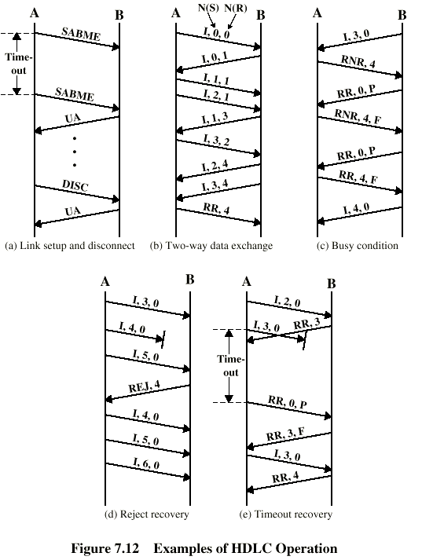
Examples of Operation (1)

Slide 25
Examples of Operation (2)

Slide 26
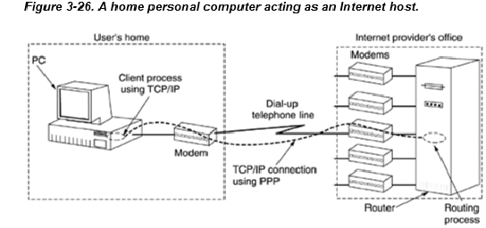
The Data Link Layer in the Internet
The Internet consists of individual machines (hosts and routers) and the communication infrastructure that connects them.

Slide 27
POINT TO POINT PROTOCOL
DLL protocol
Byte oriented protocol

Slide 28
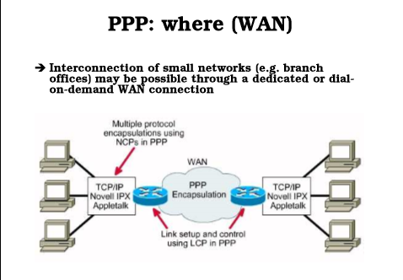
POINT TO POINT PROTOCOL

Slide 29
Provides services
Define format of frame to be exchanged between devices.
Defines how two devices can negotiate the establishment of the link and exchange of data.
Defines how network layer data are encapsulated in the data link frame.
Defines 2 devices can authenticate each other.
Provides multiple network layer services supporting a variety of network layer protocols
Provides connection over multiple links.
Provides network address configuration.

Slide 30
Not provide services like
Flow control
Error control
Addressing mechanism to handle frames in a multipoint configuration.

Slide 31
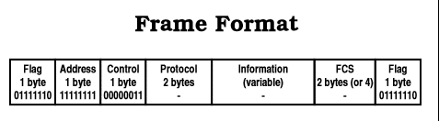
framing
It’s a byte oriented protocol.

Slide 32
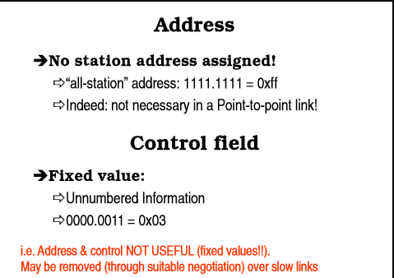

Slide 33
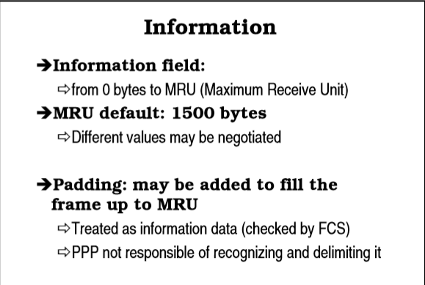
Protocol field: This field specifies the kind of packet in the data field i.e. what is being carried in data field.

Slide 34
FCS field: The frame checks sequence. It is either of 2 bytes or 4 bytes. It contains the checksum.
Byte Stuffing: same as HDLC

Slide 35
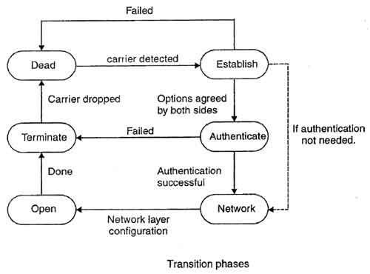
Transition Phases

Slide 36
1.Dead: In dead phase the link is not used. There is no active carrier and the line is quiet.
2. Establish: Connection goes into this phase when one of the nodes start communication. In this phase, two parties negotiate the options. If negotiation is successful, the system goes into authentication phase or directly to networking phase. LCP packets are used for this purpose.

Slide 37
3.Authenticate: This phase is optional. The two nodes may decide during the establishment phase, not to skip this phase. However if they decide to proceed with authentication, they send several authentication packets. If the result is successful, the connection goes to the networking phase; otherwise, it goes to the termination phase.

Slide 38
4.Network: In network phase, negotiation for the network layer protocols takes place. PPP specifies that two nodes establish a network layer agreement before data at the network layer can be exchanged. This is because PPP supports several protocols at network layer. If a node is running multiple protocols simultaneously at the network layer, the receiving node needs to know which protocol will receive the data.

Slide 39
5.Open: In this phase, data transfer takes place. The connection remains in this phase until one of the endpoints wants to end the connection.
6.Terminate: In this phase connection is terminated.

Slide 40
PPP uses a set of protocols to establish the link, authenticate the parties involved ,carry network layer data.
3 set of protocols are defined to make PPP powerful.
Link Control Protocols(LCP)
2 Authentication Protocols
Several Network Control Protocols

Slide 41
Link Control Protocol
Resposible for establishing ,maintaining,configuring and terminating links.
LCP used to automatically agree upon:
  varying limits on sizes of packets
  detect other common misconfiguration errors.

Slide 42
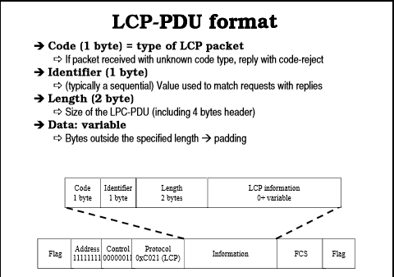

Slide 43
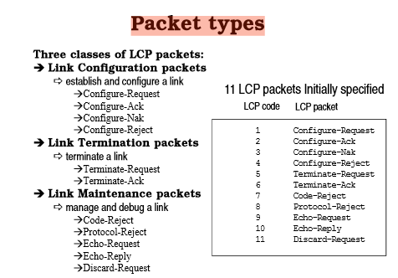

Slide 44
Authentication Protocol
Authentication :validating the identity of a user who needs to access a set of resources .
Ppp has 2 protocols
  PAP(password Authentication Protocol)
  CHAP(Challenge Handshake Authentication Protocol)

Slide 45
PAP
2 step process
The user who wants to access a system sends an authentication identification and a password.
The system checks the validity of the identification and either accepts or denies connection.

Slide 46
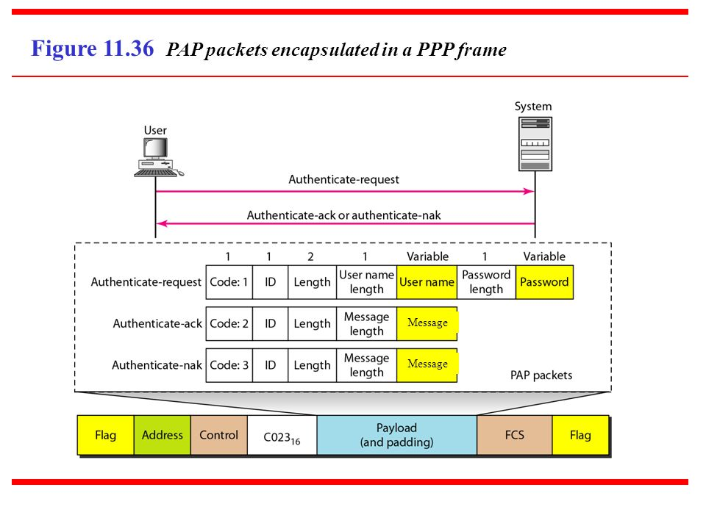

Slide 47
CHAP
3 way handshaking authentication protocol,greater security than PAP.
The system sends the user a challenge packet containing a challenge value ,usually a few bytes.
User applies a predefined function that takes the challenge value and user’s password and create a result.
The user sends the result in the response packet to the system.
The system does the same.(system applies same function to the password and the challenge value to create a result.

Slide 48
The system does the same.(system applies same function to the password and the challenge value to create a result.
If both same ,access granted.

Slide 49
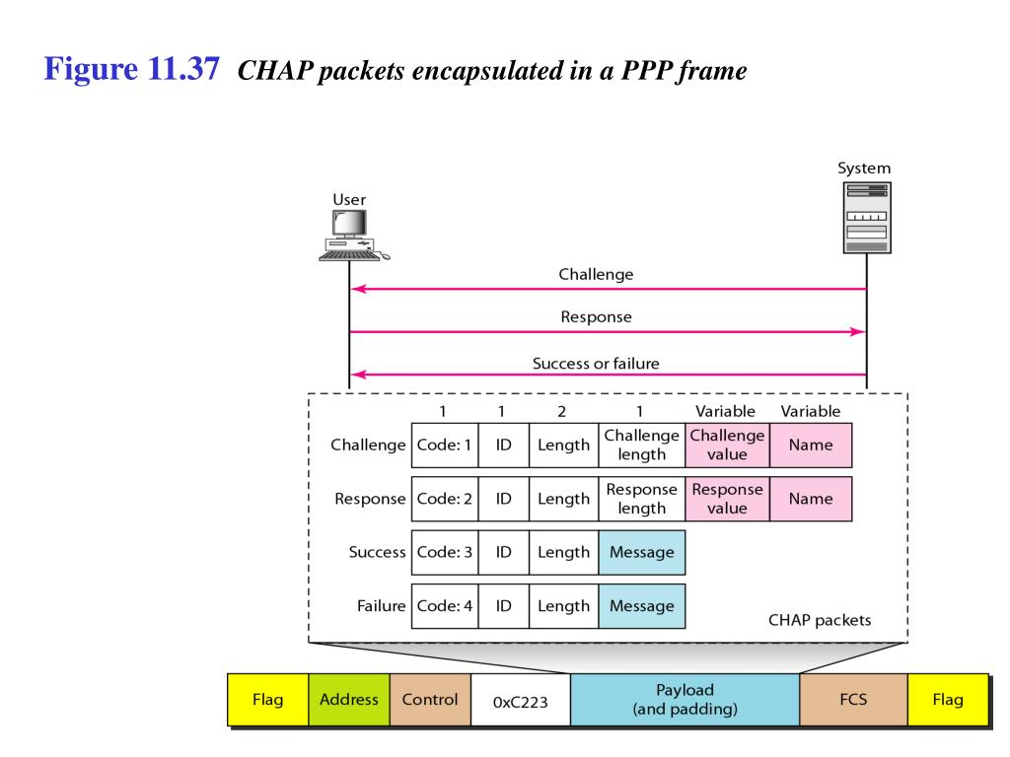

Slide 50
Network Control Protocol
PPP can carry a network layer data packet from protocols defined by internet OSI,Xerox,Appletalk and so on.
To do this ,PPP has defined a specific NCP for each network Protocol,
For exampel IPCP
This link used to carry IP packets in the internet

Slide 51
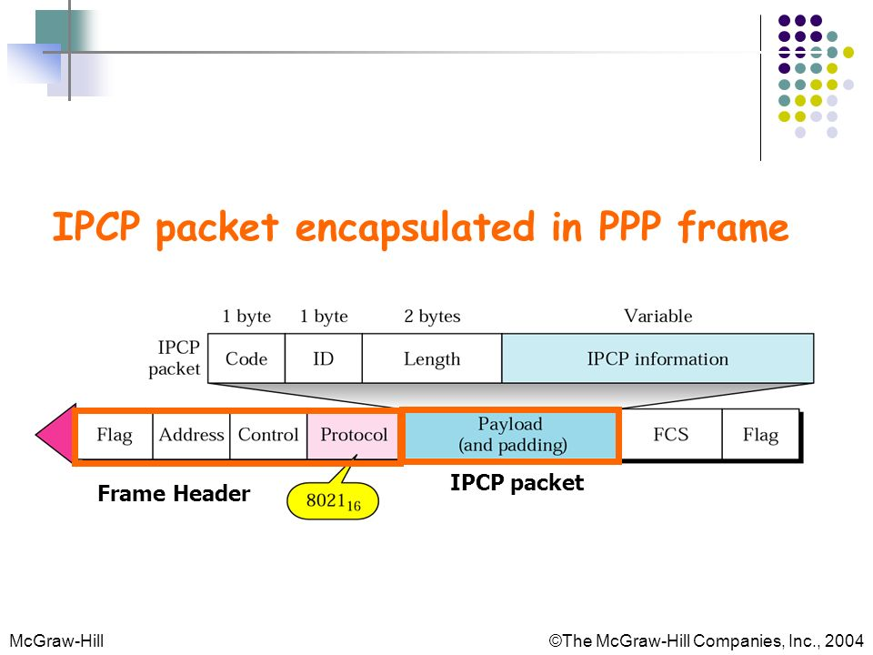

Slide 52
The Medium Access Control Sublayer
In any broadcast network, the key issue is how to determine who gets to use the channel when there is competition for it.
broadcast channels are sometimes referred to as multiaccess channels or random access channels.
The protocols used to determine who goes next on a multi access channel belong to a sublayer of the data link layer called the MAC (Medium Access Control) sublayer.

Slide 53
The Channel Allocation Problem
how to allocate a single broadcast channel among competing users.

Slide 54
Static Channel Allocation in LANs and MANs
Frequency Division Multiplexing (FDM)

Slide 55
Multiple Access Protocols
ALOHA
  2 types
  Pure ALOHA
  Slotted ALOHA

Slide 56
Pure ALOHA
users can transmit whenever they have data to be sent.
There will be collisions, and the colliding frames will be damaged.
due to the feedback property of broadcasting, a sender can always find out whether its frame was destroyed by listening to the channel,
If the frame was destroyed, the sender just waits a random amount of time and sends it again.
The waiting time must be random or the same frames will collide over and over,

